Slide 1
Using Amazon Mechanical Turk for Product Term Annotation
Gabor Melli
Dec. 4, 2013

Slide 2
Opportunity Statement
Enhance our capability to create semantic data
Current process is to have Diana, Gabor, random acquaintances (CPROD1), employees (accessory)
Current semantic data and tasks:
  dictionary_term (population + cleaning)
  Training data (creation + cleaning) for:
    Producty term recognizer in user-generated webpage
    Term recognition in product titles
Future: “substitutable products”

Slide 3
Current term review process

Slide 4
Current term review process

Slide 5
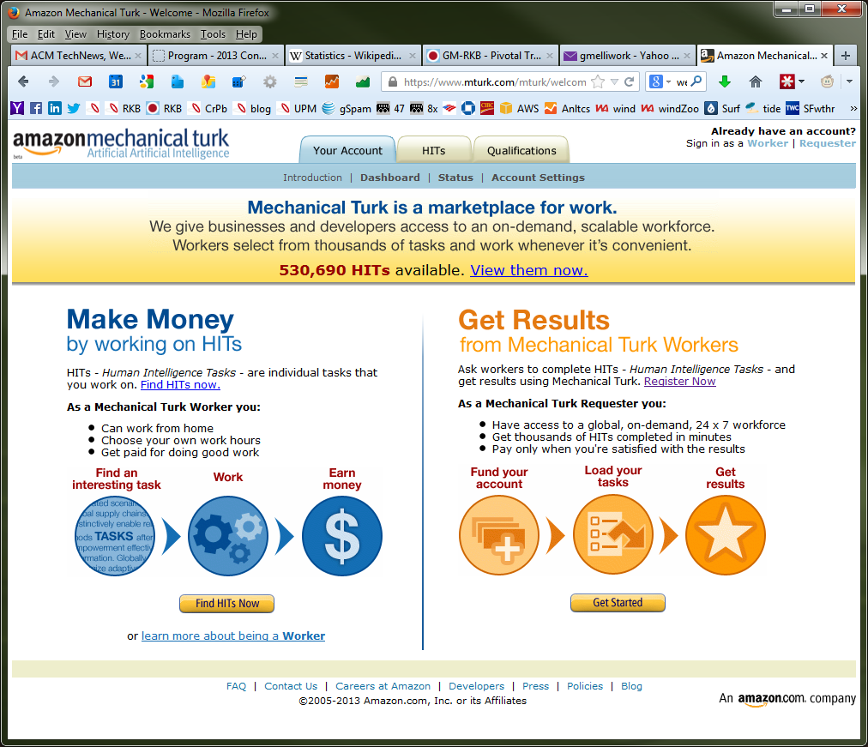

Slide 6
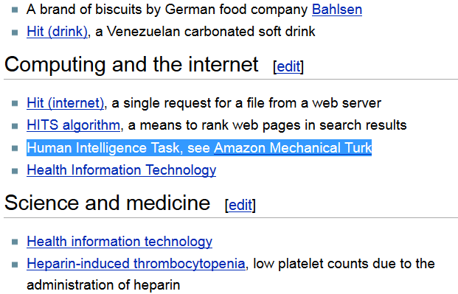
Human-Intelligence Task (HIT)
What is a HIT?
A Human Intelligence Task, or HIT, is a question that needs an answer. A HIT represents a single, self-contained task that a Worker can work on, submit an answer, and collect a reward for completing.

Slide 7
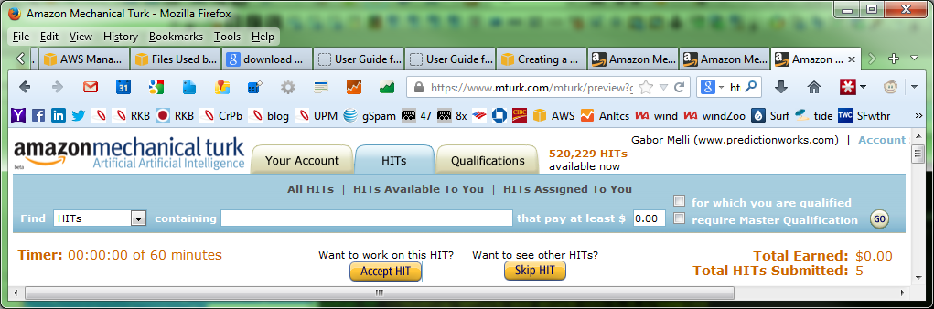
Searching for HITs

Slide 8
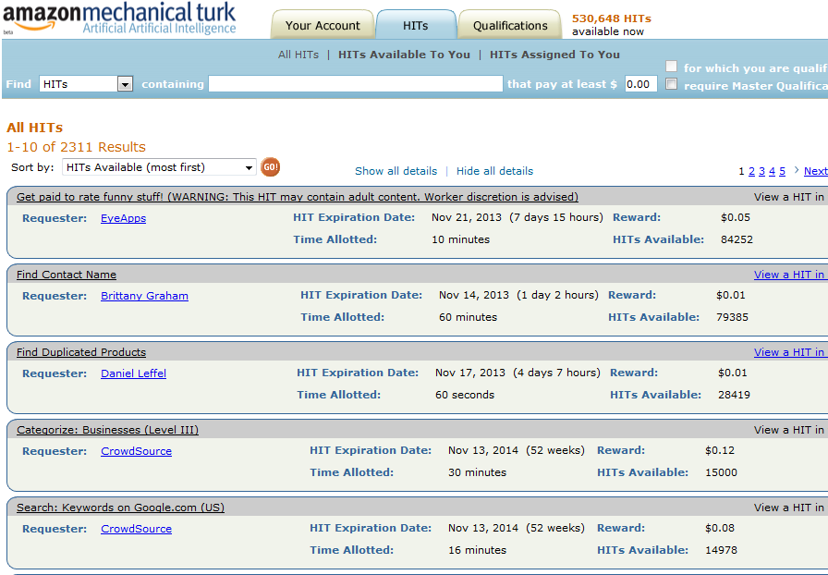

Slide 9
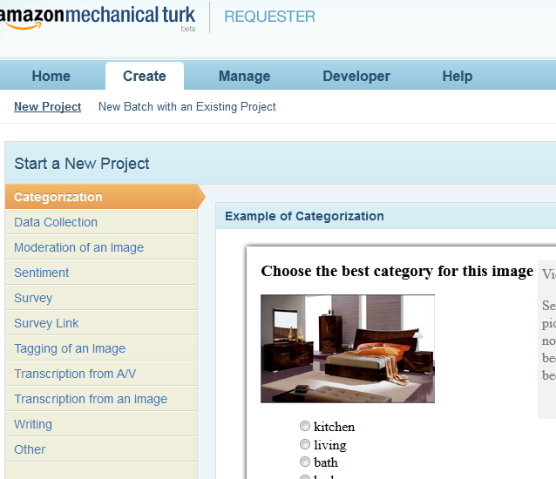

Slide 10
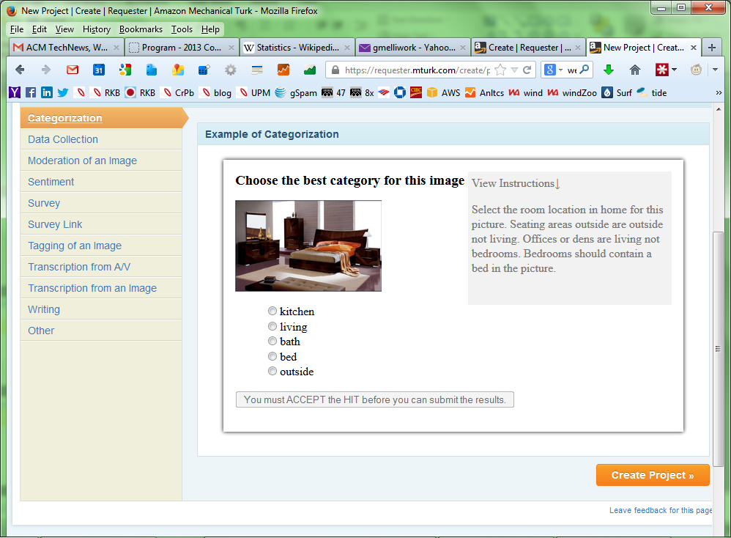

Slide 11
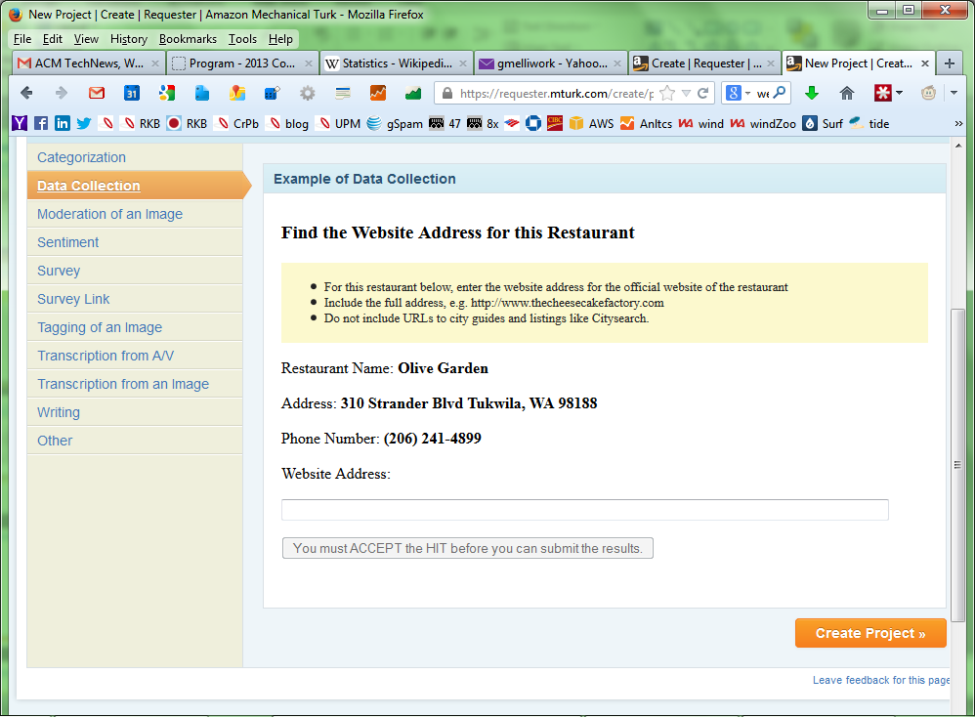

Slide 12
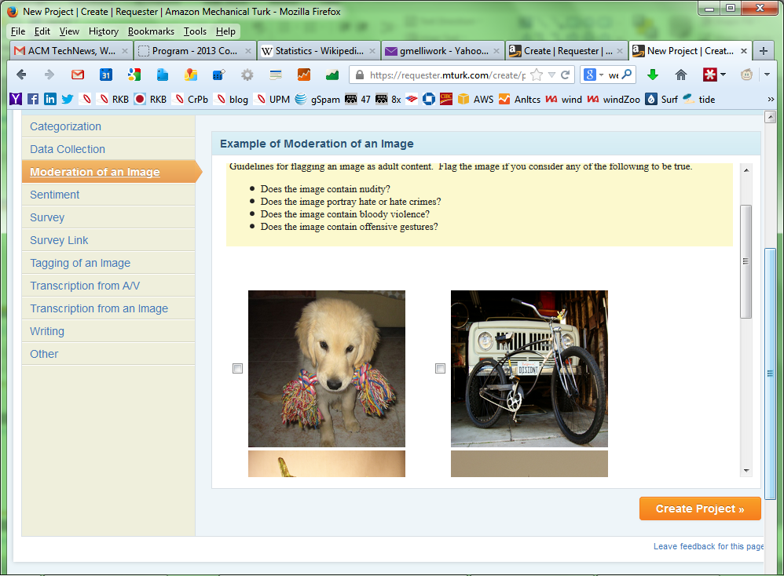

Slide 13
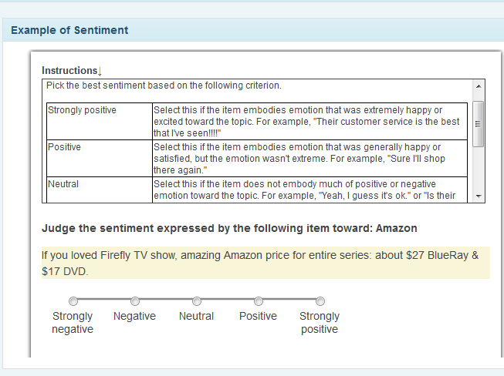

Slide 14
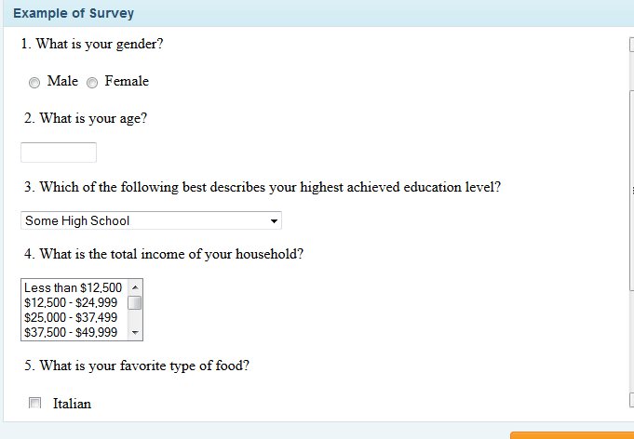

Slide 15
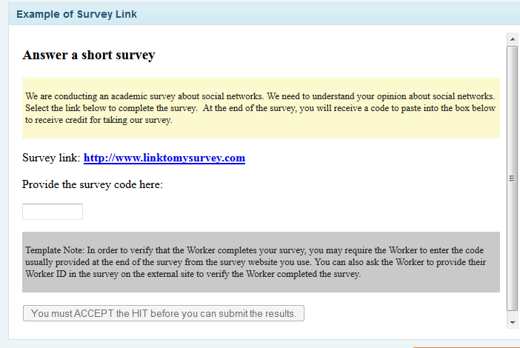

Slide 16
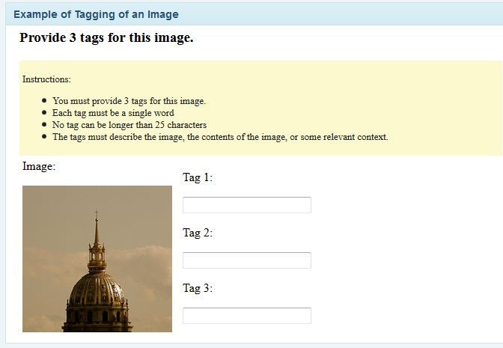

Slide 17
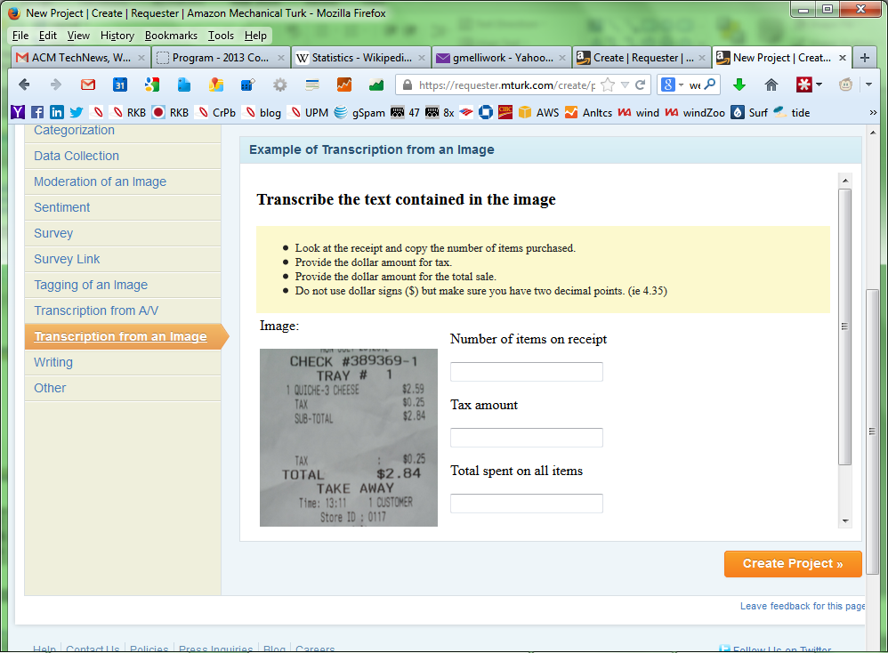

Slide 18
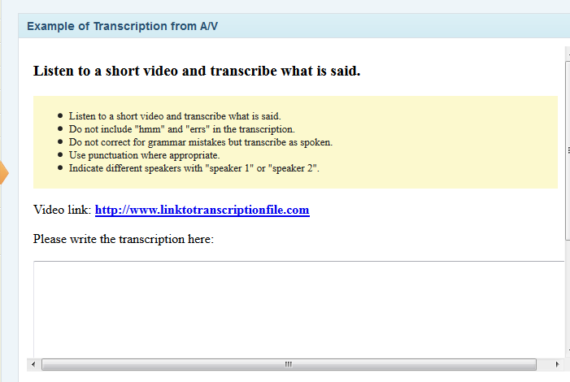

Slide 19
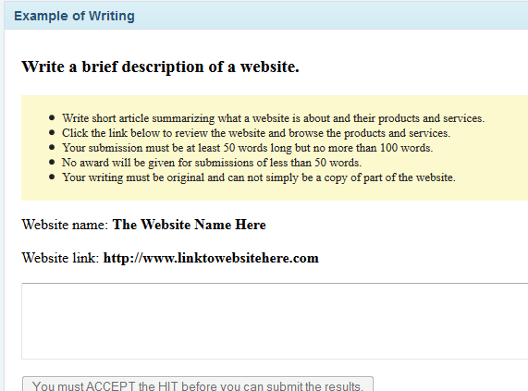

Slide 20
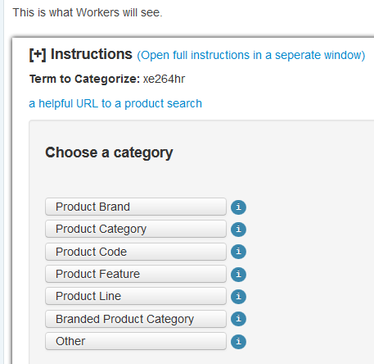

Slide 21
Prepared feed

Slide 22
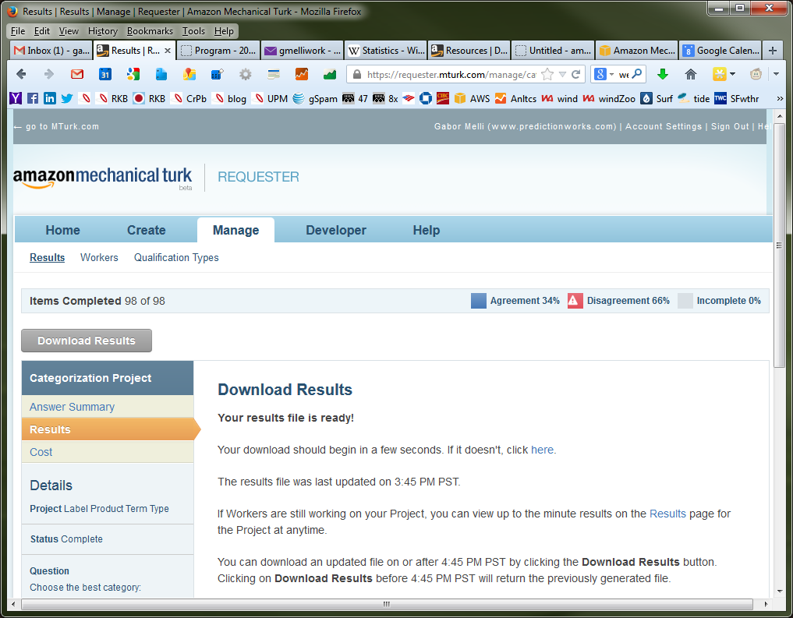

Slide 23
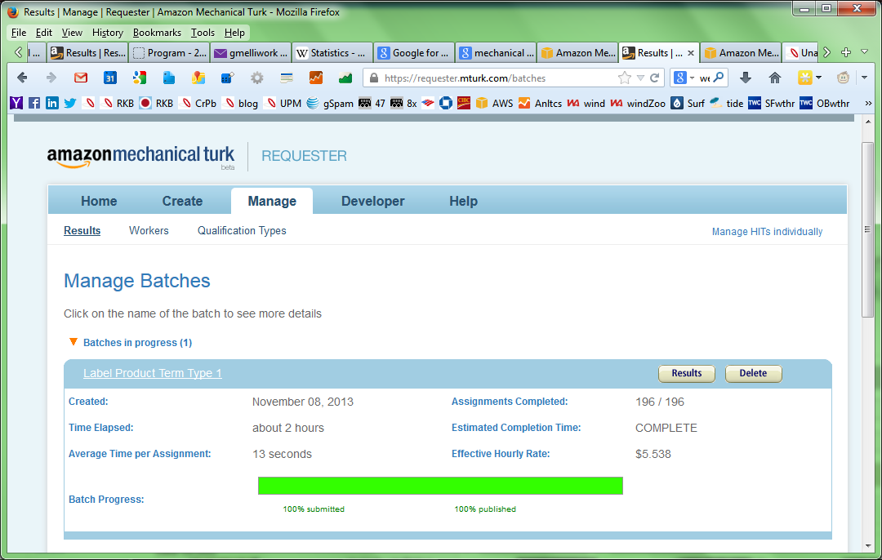

Slide 24
Observations on 1st attempt
(5-label categ. / UI-based config.)
Weak performance on ‘complete’ task as a single HIT => break-up into simpler tasks
Move to using automatable-API based configuration
  Unix script-based or Code-based support
  Requires complete reconfig (no reusability yet from UI-based version).

Slide 25
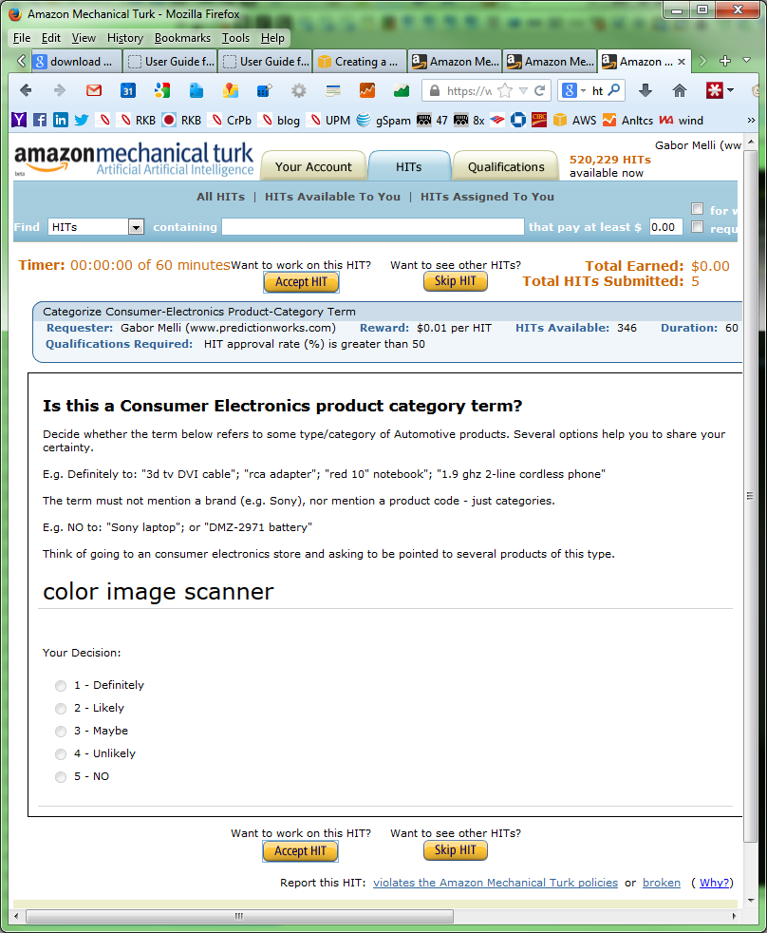

Slide 26
$ cat PC-CE.question.txt
<?xml version="1.0"?> <QuestionForm xmlns="http://mechanicalturk.amazonaws.com/AWSMechanicalTurkDataSchemas/2005-10-01/QuestionForm.xsd"> <Overview>
<Title>Is this a Consumer Electronics product category term?</Title>
<Text>Decide whether the term below refers to some type/category of Consumer Electronics products. Several options help you to share your certainty.
E.g. 3d tv; rca adapter; 10" notebook; 1.9 ghz 2-line cordless phone
The term must not mention a brand (e.g. Sony), nor mention a product code - just categories.
E.g. NO to: "Sony laptop"; or "DMZ-2971 battery"
Think of going to an consumer electronics store and asking to be pointed to several products of this type.
</Text> <FormattedContent><![CDATA[
<font size="+2"> ${term_to_categorize} </font>
]]></FormattedContent>
</Overview> <Question> <QuestionIdentifier>category</QuestionIdentifier> <QuestionContent><Text>Category:</Text></QuestionContent>
<AnswerSpecification> <SelectionAnswer> <MinSelectionCount>1</MinSelectionCount>
<StyleSuggestion>radiobutton</StyleSuggestion>
<Selections>
#set ( $categories = [ "1 - Definitely","2 - Likely","3 - Maybe","4 - Unlikely","5 - NO" ] )
#foreach ( $category in $categories )
<Selection> <SelectionIdentifier>$category</SelectionIdentifier>
<Text>$category</Text> </Selection> #end </Selections> </SelectionAnswer> </AnswerSpecification> </Question> </QuestionForm>

Slide 27
$ cat PC-CE.properties.txt
## Basic HIT Properties
title:Consumer Electronics Product Category Term?
description:Does this term refer to a Consumer Electronics product category?
keywords:category, categorize, consumer product, text, term
reward:0.01
assignments:2
annotation:${term_to_categorize}
## HIT Timing Properties
assignmentduration:3600
hitlifetime:20000
autoapprovaldelay:259200
## Qualification Properties
# this is a built-in qualification -- user must have > 50% approval rate
qualification.1:000000000000000000L0
qualification.comparator.1:greaterthan
qualification.value.1:50
qualification.private.1:false

Slide 28
aws-mturk-clt-1.3.1/samples/CE-PC$ ./run.sh
--[Initializing]----------
Input: ../samples/CE-PC/CE-PC.input
Properties: ../samples/CE-PC/CE-PC.properties
Question File: ../samples/CE-PC/CE-PC.question
Preview mode disabled
--[Loading HITs]----------
Start time: Thu Nov 14 04:04:31 UTC 2013
Created HIT 1: HITId=2LRF9SSSHX11JODUSU85Q8J4OBHVZH
Created HIT 2: HITId=2NFBAT2D5NQYN555PPAGGTYMNYB370
Created HIT 3: HITId=2AOS8SV7WGKCCVBN2113EMHAPCJ0Q0
<SNIP>
Created HIT 344: HITId=2JV5NQYN5F3Q0J67SNDNNWYB4VVC8V
Created HIT 345: HITId=27DJ8EBDPGFL6V2RVO0RYDWIOHH1GA
Created HIT 346: HITId=2C8VJ8EBDPGFL6LEOLQ92NDWIABF0M
You may see your HIT(s) with HITTypeId '2MK98D8J3VE7WSIVMN3GEMCK8AEHXP' here:
https://www.mturk.com/mturk/preview?groupId=2MK98D8J3VE7WSIVMN3GEMCK8AEHXP
End time: Thu Nov 14 04:04:45 UTC 2013
--[Done Loading HITs]----------
Total load time: 14 seconds.
Successfully loaded 346 HITs.

Slide 29
ubuntu@adhoc-master:./PC-term-review$ ./downloadHITresults.sh 131204
CE
--[Retrieving Results]----------
Retrieved HIT 1/100, 2S3YHVI44OS2KLKACC5Z3BAP5724YT
Retrieved HIT 2/100, 2T1011K274J79KGY5QZNF6UXF8ECEZ
… <SNIP> …
Retrieved HIT 99/100, 2VUWA6X3YOCCF02R49OP4INIITZPOU
Retrieved HIT 100/100, 2SIHFL42J1LY58191WD0TGFKH92N2Q
--[Done Retrieving Results]----------
Results have been written to file '/mnt/gabor_drive/AMTurk/PC-term-review/PC-SF.131204.results'.
Assignments completed: 200/200 (100%)
Time elapsed: 2:41:01 (h:mm:ss)
Average submit time: 8.4 seconds
ubuntu@adhoc-master:./PC-term-review$ wc -l *results
159 PC-AU.131204.results
…
201 PC-CE.131204.results
1411 total

Slide 30
./reportConfidentPredictions.sh 131204 | wc -l
463
./reportConfidentPredictions.sh 131204 | grep 2xYES | sort --random-sort | head -8
2xYES audio signal CE PC
2xYES soccer sneaker FS PC
2xYES charger kit CM PC
2xYES neck strap & batteries CP PC
2xYES digital slr kit CP PC
2xYES wheeled luggage FS PC
2xYES brewer HG PC
2xYES digital filing system CE PC
./reportConfidentPredictions.sh 131204 | grep 2xNO | sort --random-sort | head -8
2xNO audio dock CE PC
2xNO holster fits SF PC
2xNO kids games CM PC
2xNO key chain kit CM PC
2xNO girls vintage SF PC
2xNO black painting CE PC
2xNO crisp bars HB PC
2xNO log periodic yagi antenna CM PC
manually review (e.g. BL-also terms); batch insert into dict
| cat - > negativePhrases.131204.txt

Slide 31
./create2annotate.sh negativePhrases.131204.txt newAmazonTitles.131202.tsv | head -7
[[BN|Never Too]] [[PF|Small To Rock]] [[PL|Guitar Onesie]] [[PF|Bodysuit]] [[PC|Infant Boys]] ( [[PF|3-6 Months]] )
[[PF|Tripett Green]] [[PF|Beef Tripe Original Formula for Dogs]] ( [[PF|Pack of 12]] , [[PF|13 Ounce Cans]] )
[[P|POOF-Slinky 0C470 Ideal 100-Trick Spectacular Magic]] [[PC|Show Set]] [[PF|with Instructional DVD]]
[[BN|Sunpro]] [[P|CP8213]] [[PF|StyleLine]] [[PC|Mechanical Vacuum]] / [[PF|Boost Gauge]] - [[PF|Black Dial]]
[[PL|Rocio]] Illumini [[BN|Polaris]] [[PF|Rhodium Plated]] [[PF|Silver]] [[PF|White]] [[PF|Swarovski Zirconia Stylish]] [[PC|Drop Earrings]]
[[BN|T-fal]] [[P|A777SI64]] [[PL|Initiatives]] [[PF|Nonstick Inside and Out]] [[PF|Dishwasher Safe]] [[PF|18-Piece]] [[PF|Cookware Set]] , [[PF|Red]]
[[PL|Sony MDRXB60EX]] / [[PF|GLD]] [[PF|Extra Bass]] [[PF|In Ear 13.5mm Driver]] [[PC|Headphone]] , [[PF|Gold]]

Slide 32
Future Steps
Continue using for weekly term classification.
Test ability to classify whether a segment is correctly annotated?
…

Slide 33
The End

Slide 34
Greetings from Amazon Mechanical Turk,
The following is a summary of your Amazon Mechanical Turk activity for Dec 03, 2013.
Daily HIT activity
- Number of HITs created: 701
Daily HIT assignment activity
- Number of assignments accepted by users: 1,402
- Number of assignments submitted by users: 1,402
- Number of approved assignments: 0
- Number of rejected assignments: 0

Slide 35
Greetings from Amazon Mechanical Turk,
The following is a summary of your Amazon Mechanical Turk activity for Nov 08, 2013.
Daily HIT activity
- Number of HITs created: 667
Daily HIT assignment activity
- Number of assignments accepted by users: 250
- Number of assignments submitted by users: 250
- Number of approved assignments: 250
- Number of rejected assignments: 0
Payments summary
- Amount paid to users for completed and approved HITs: $5.000
- Bonus rewards paid to users: $0.000
- Commission paid to Amazon Mechanical Turk for approved HITs and bonus rewards: $2.250
Sincerely,
Amazon Mechanical Turk
https://requester.mturk.com
410 Terry Avenue North
SEATTLE, WA 98109-5210 USA

Slide 36
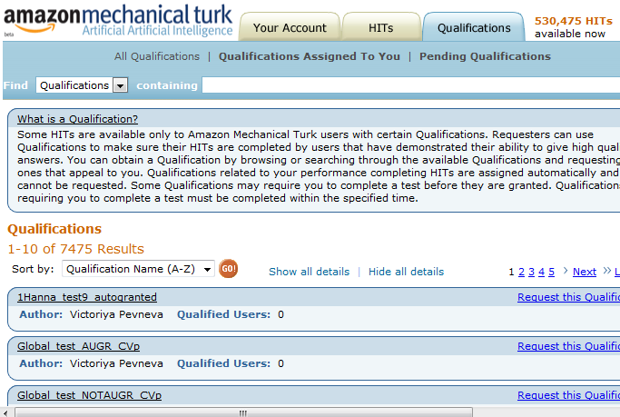

Slide 37
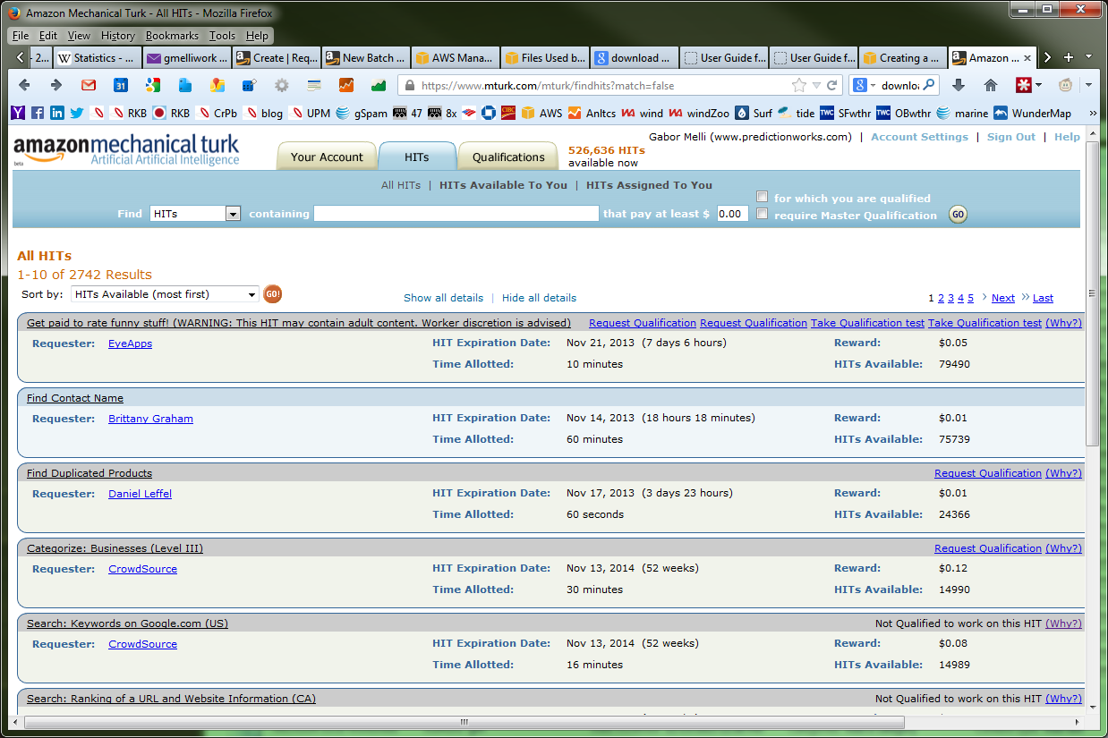
Not qualified to work on this HIT You are not qualified to accept this HIT for the following reason(s): This HIT requires that your Total approved HITs Qualification have a value that meets the requirement "is not less than 200". This Qualification represents an aspect of your account status or history. You can improve some Qualifications, such as HIT submission rate and HIT approval rate, by successfully completing other HITs.

Slide 38
Greetings from Amazon Mechanical Turk,
The following is a summary of your Amazon Mechanical Turk activity for Nov 13, 2013.
Daily HIT activity
- Number of HITs created: 489
Daily HIT assignment activity
- Number of assignments accepted by users: 978
- Number of assignments submitted by users: 978
- Number of approved assignments: 286
- Number of rejected assignments: 0
Payments summary
- Amount paid to users for completed and approved HITs: $5.720
- Bonus rewards paid to users: $0.000
- Commission paid to Amazon Mechanical Turk for approved HITs and bonus rewards: $2.574

Slide 40
https://www.google.com/#q=Caldwell+Brass+Trap&tbm=shop

