Slide 1
Regression Tree
Learning
Gabor Melli
July 18th, 2013

Slide 2
Overview
What is a regression tree?
How to train a regression tree?
How to train one with R’s rpart()?
How to train one with BigML.com?

Slide 3
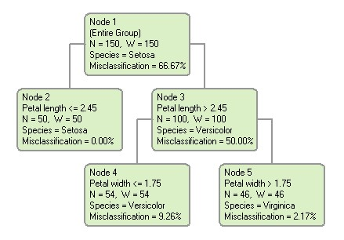
Familiar with Classification Trees?
Notes:
http://www.dtreg.com/classregress.htm

Slide 4
What is a Regression Tree?
a trained predictor tree that is a regressed point estimation function (where each leaf node and typically also internal nodes makes a point estimate).
If test₁
0.7
test₂
5.7
1.1
2.9

Slide 5
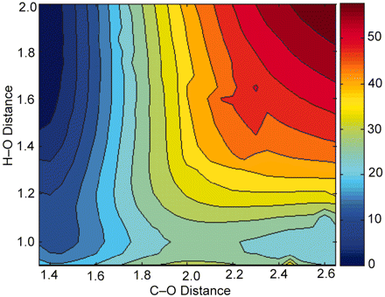
Approach: recursive top-down greedy
Avg=14
Err=0.12
Avg=87
Error=0.77
x<1.54 then z=14 else z=87
Notes:
http://www.pnas.org/content/105/44/16918/F3.expansion.html

Slide 6
Divide the sample space with orthogonal hyperplanes
Mean=27
error=0.19
Mean=161
Error=0.23
x<1.93 then 27 else 161
Notes:
http://www.pnas.org/content/105/44/16918/F3.expansion.html

Slide 7
Approach: recursive top-down greedy
Avg=54
Err=0.92
Avg=61
Error=0.71
Notes:
http://www.pnas.org/content/105/44/16918/F3.expansion.html

Slide 8
Divide the sample space with orthogonal hyperplanes
err=0.12
_{err=0.09}
Notes:
http://www.pnas.org/content/105/44/16918/F3.expansion.html

Slide 9
Divide the sample space with orthogonal hyperplanes
Notes:
http://www.pnas.org/content/105/44/16918/F3.expansion.html

Slide 10
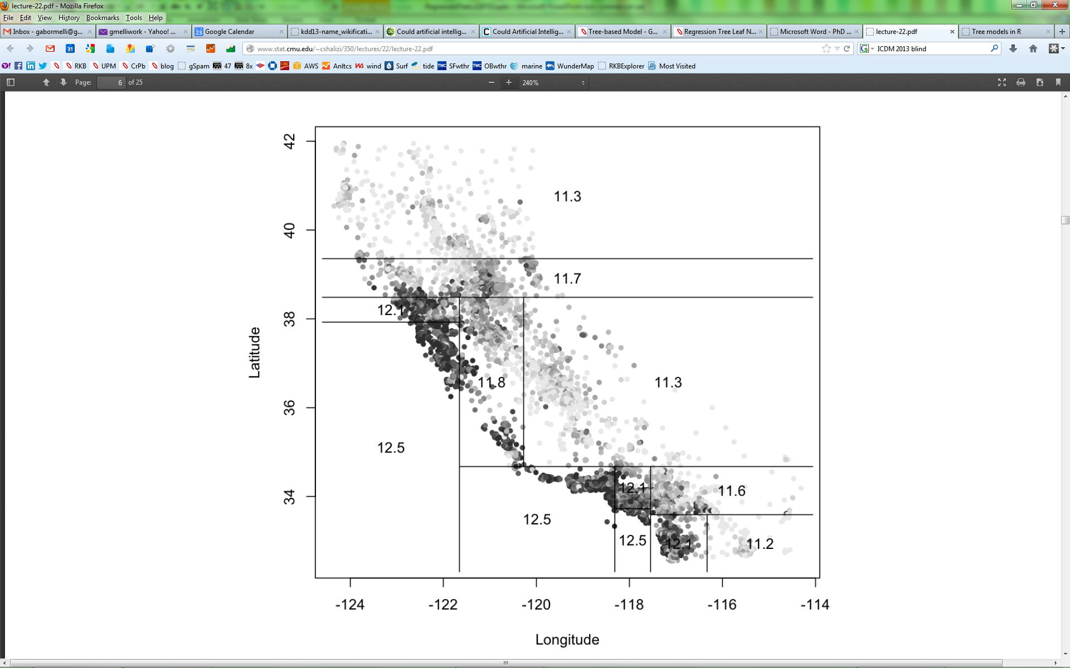

Slide 11
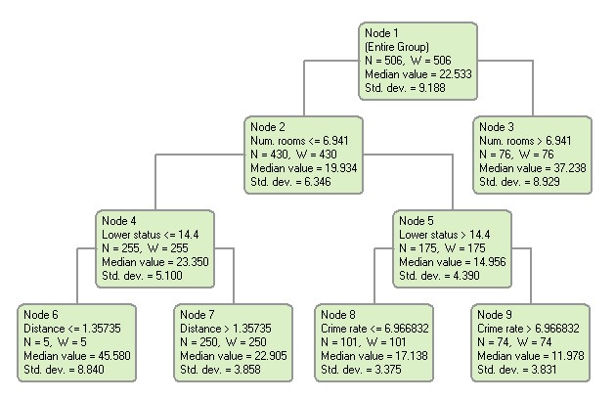
Regression Tree (sample)
Notes:
http://www.dtreg.com/classregress.htm

Slide 12
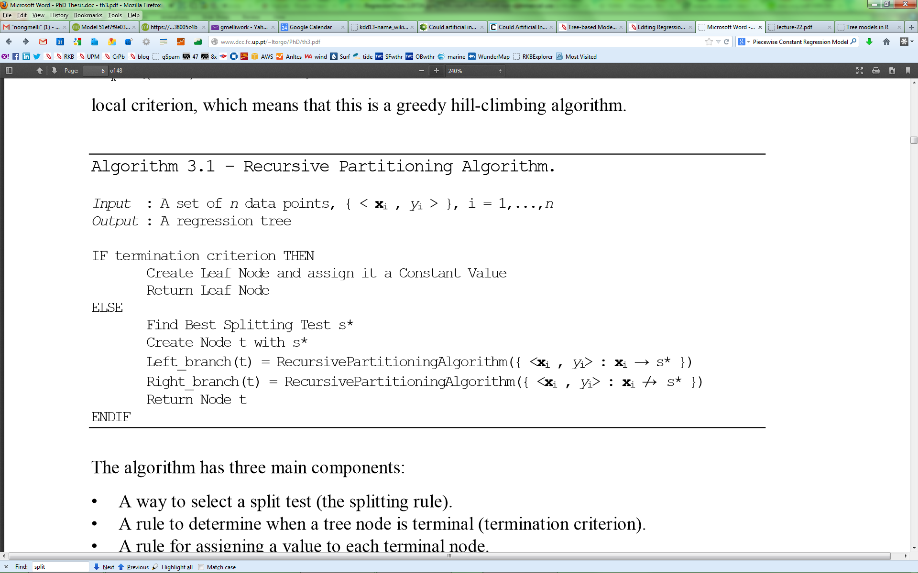
Notes:
http://www.dcc.fc.up.pt/~ltorgo/PhD/th3.pdf

Slide 13
Stopping Criterion
If all records have the same target value.
If there are fewer than n records in set.

Slide 14
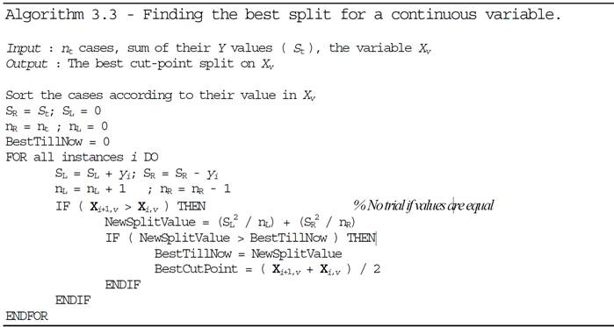

Slide 15
Example

Slide 16
R Code
library(rpart);
# Load the data
synth_epc <- read.delim("synth_epc.tsv") ;
attach(synth_epc) ;
# Train the decision trees
synth_epc.rtree <- rpart(epcw0 ~ merch + user + epcw1 + epcw2, synth_epc[,1:5], cp=0.01) ;

Slide 17
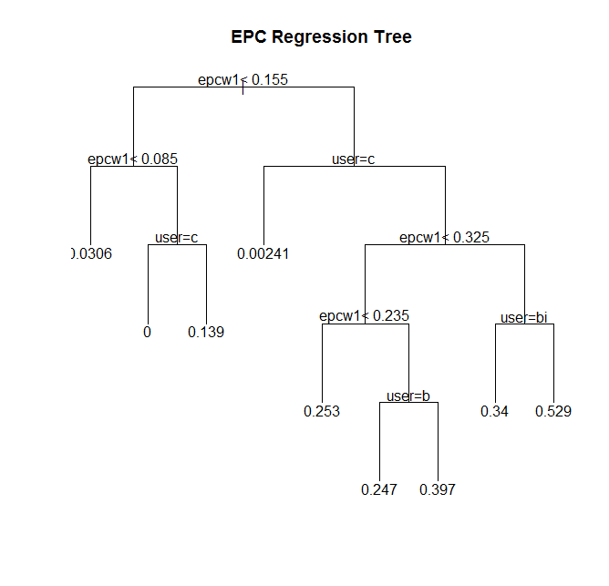
# Display the tree plot(synth_epc.rtree, uniform=T, main="EPC Regression Tree"); text(synth_epc.rtree, digits=3) ;

Slide 18
synth_epc.rtree ;
1) root 499 15.465330000 0.175831700
2) epcw1< 0.155 243 0.902218100 0.062551440
4) epcw1< 0.085 156 0.126648100 0.030576920 *
5) epcw1>=0.085 87 0.330098900 0.119885100
10) user=userC 12 0.000000000 0.000000000 *
11) user=userA,userB,userD,userE,userF,userG,userH,userI,userJ,userK 75 0.130034700 0.139066700 *
3) epcw1>=0.155 256 8.484911000 0.283359400
6) user=userC 54 0.000987037 0.002407407 *
7) user=userA,userB,userD,userE,userF,userG,userH,userI,userJ,userK 202 3.082024000 0.358465300
14) epcw1< 0.325 147 1.113675000 0.305034000
28) epcw1< 0.235 74 0.262945900 0.252973000 *
29) epcw1>=0.235 73 0.446849300 0.357808200
58) user=userB 19 0.012410530 0.246842100 *
59) user=userA,userD,userE,userF,userG,userH,userI,userJ,userK 54 0.118164800 0.396851900 *
15) epcw1>=0.325 55 0.427010900 0.501272700
30) user=userB,userI 8 0.055000000 0.340000000 *
31) user=userA,userD,userE,userF,userG,userH,userJ,userK 47 0.128523400 0.528723400 *

Slide 19
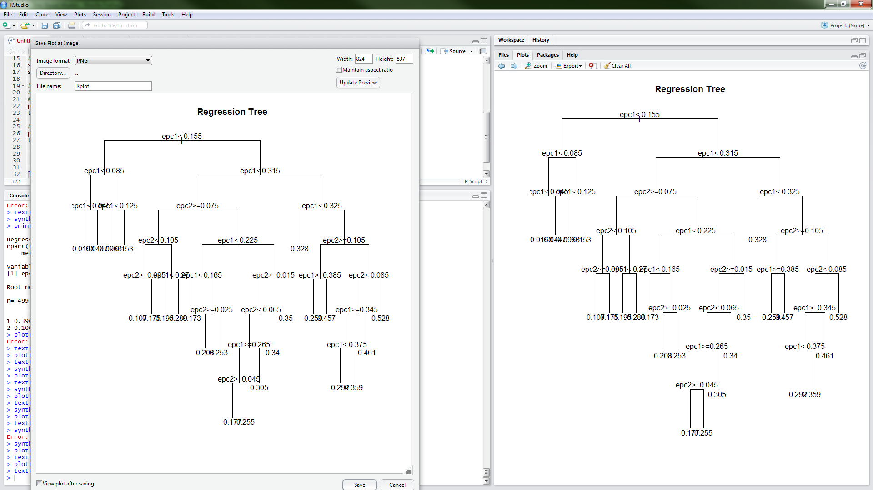

Slide 20

BigML.com

Slide 21
Java class output
/* Predictor for epcw0 from model/51ef7f9e035d07603c00368c
* Predictive model by BigML - Machine Learning Made Easy */
public static Double predictEpcw0(String user, Double epcw2, Double epcw1) {
if (epcw1 == null) {
return 0.18253D;
}
else if (epcw1 <= 0.165) {
if (epcw1 > 0.095) {
if (user == null) {
return 0.13014D;
}
else if (user.equals("userC")) {
return 0D;
…

Slide 22
PMML output
|<?xml version="1.0" encoding="utf-8"?>
<PMML version="4.1" xmlns="http://www.dmg.org/PMML-4_1" xmlns:xsi="http://www.w3.org/2001/XMLSchema-instance">
<Header description="Generated by BigML"/>
<DataDictionary>
<DataField dataType="string" displayName="user" name="000001" optype="categorical">
<Value value="userC"/>
…
<Node recordCount="202" score="0.06772">
<SimplePredicate field="000003" operator="lessOrEqual" value="0.165"/>
<Node recordCount="72" score="0.13014">

Slide 23
Pruning
# Prune and display tree
synth_epc <-prune(synth_epc,cp=0.0055)

Slide 24
Determine the Best Complexity Parameter (cp) Value for the Model
Cross-Validated Error
Cross-Validated Error SD
size of tree
Complexity
Parameter
# Splits
1 – R²
1
3
5
7
11
14
17
CP nsplit rel error xerror xstd
1 0.5492697 0 1.00000 1.00864 0.096838
2 0.0893390 1 0.45073 0.47473 0.048229
3 0.0876332 2 0.36139 0.46518 0.046758
4 0.0328159 3 0.27376 0.33734 0.032876
5 0.0269220 4 0.24094 0.32043 0.031560
6 0.0185561 5 0.21402 0.30858 0.030180
7 0.0167992 6 0.19546 0.28526 0.028031
8 0.0157908 7 0.17866 0.27781 0.027608
9 0.0094604 9 0.14708 0.27231 0.028788
10 0.0054766 10 0.13762 0.25849 0.026970
11 0.0052307 11 0.13215 0.24654 0.026298
12 0.0043985 12 0.12692 0.24298 0.027173
13 0.0022883 13 0.12252 0.24396 0.027023
14 0.0022704 14 0.12023 0.24256 0.027062
15 0.0014131 15 0.11796 0.24351 0.027246
16 0.0010000 16 0.11655 0.24040 0.026926
1.2
1.0
0.8
X-val Relative Error
0.6
0.4
0.2
Inf
0.03
0.0072
0.0012
cp

Slide 25
We can see that we need a cp value of about 0.008 - to give a tree with 11 leaves or terminal nodes

Slide 26
Reduced-Error Pruning
A post-pruning, cross validation approach
  Partition training data into “grow” set and “validation” set.
  Build a complete tree for the “grow” data
  Until accuracy on “validation” set decreases, do:
    For each non-leaf node in the tree
      Temporarily prune the tree below; replace it by majority vote.
      Test the accuracy of the hypothesis on the validation set
      Permanently prune the node with the greatest increase in accuracy on the validation test.
Problem: Uses less data to construct the tree
Sometimes done at the rules level
  Rules are generalized by erasing a condition (different!)
General Strategy: Overfit and Simplify

Slide 27
Regression Tree Pruning
Regression Tree
Before Pruning
Regression Tree
After Pruning
cach< 27
cach< 27
|
|
mmax< 6100
mmax< 2.8e+04
mmax< 6100
mmax< 2.8e+04
mmax< 1750
syct>=360
cach< 96.5
cach< 56
mmax< 2500
chmin< 5.5
mmax< 1.124e+04
mmax< 1750
syct>=360
cach< 96.5
cach< 56
2.51
2.95
5.35
5.22
6.14
chmax< 4.5
cach< 0.5
chmax< 14
3.05
4.55
4.21
2.51
3.29
chmin< 5.5
5.22
6.14
syct< 110
chmin>=1.5
2.95
mmax< 1.1e+04
3.12
3.52
4.69
5.14
5.35
mmax< 1.4e+04
cach< 0.5
3.26
3.54
3.89
4.55
4.21
4.92
4.04
4.31
3.52
4.03

Slide 28
How well does it fit?
Plot of residuals

Slide 29
Testing w/Missing Values

Slide 30
THE END

Slide 31
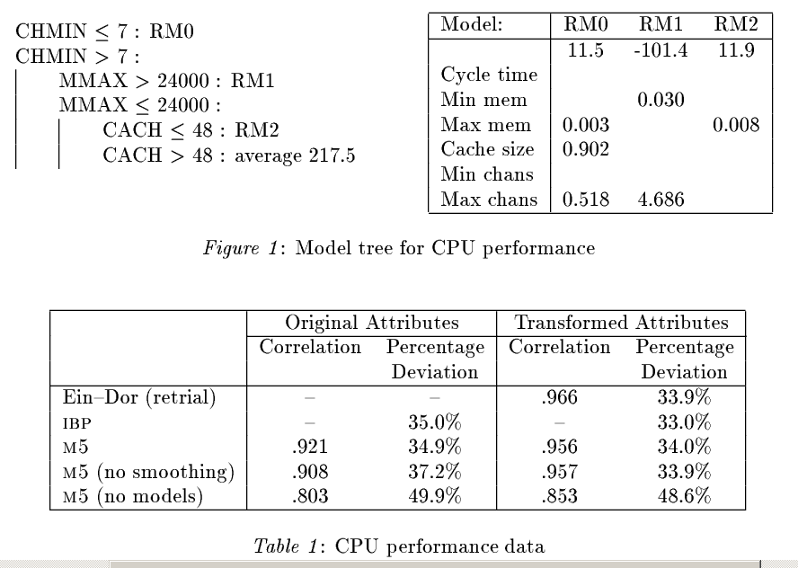
Regression trees: example - 1

Slide 33
R Code
library(rpart);
library(MASS); data(cpus); attach(cpus)
# Fit regression tree to data
cpus.rp <-rpart(log(perf)~.,cpus[,2:8],cp=0.001)
# Print and plot complexity Parameter (cp) table
printcp(cpus.rp); plotcp(cpus.rp)
# Prune and display tree
cpus.rp<-prune(cpus.rp,cp=0.0055)
plot(cpus.rp,uniform=T,main="Regression Tree")
text(cpus.rp,digits=3)
# Plot residual vs. predicted
plot(predict(cpus.rp),resid(cpus.rp)); abline(h=0)

Slide 34
Create a new tree T with a single root node.
IF One of the Stopping Criteria is fulfilled THEN
  Mark the root node in T as a leaf with the most common value of y in S as a label.
ELSE
  Find a discrete function f(A) of the input attributes values such that splitting S according to f(A)’s outcomes (v1,...,vn) gains the best splitting metric.
  IF best splitting metric > treshold THEN
    Label t with f(A)
    FOR each outcome vi of f(A):
      Set Subtreei= TreeGrowing (¾f(A)=viS,A,y).
      Connect the root node of tT to Subtreei with an edge that is labelled as vi
    END FOR
  ELSE
    Mark the root node in T as a leaf with the most common value of y in S as a label.
  END IF
END IF
RETURN T
Notes:
http://www.ise.bgu.ac.il/faculty/liorr/hbchap9.pdf

Slide 35
Create a new tree T with a single root node.
IF One of the Stopping Criteria is fulfilled THEN
  Mark the root node in T as a leaf with the most common value of y in S as a label.
ELSE
  Find a discrete function f(A) of the input attributes values such that splitting S according to f(A)’s outcomes (v1,...,vn) gains the best splitting metric.
  IF best splitting metric > treshold THEN
    Label t with f(A)
    FOR each outcome vi of f(A):
      Set Subtreei= TreeGrowing (¾f(A)=viS,A,y).
      Connect the root node of tT to Subtreei with an edge that is labelled as vi
    END FOR
  ELSE
    Mark the root node in T as a leaf with the most common value of y in S as a label.
  END IF
END IF
RETURN T
Notes:
http://www.ise.bgu.ac.il/faculty/liorr/hbchap9.pdf

Slide 36
Measures used in fitting Regression Tree
Instead of using the Gini Index the impurity criterion is the sum of squares, so splits which cause the biggest reduction in the sum of squares will be selected.
In pruning the tree the measure used is the mean square error on the predictions made by the tree.

Slide 37

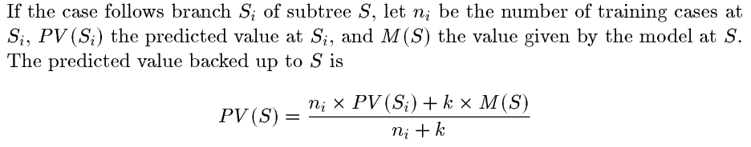
Regression trees - summary
[Quinlan’s M5]
Growing tree:
  Split to optimize information gain
At each leaf node
  Predict the majority class
Pruning tree:
  Prune to reduce error on holdout
Prediction:
  Trace path to a leaf and predict associated majority class
build a linear model, then greedily remove features
estimated error on training data
estimates are adjusted by (n+k)/(n-k): n=#cases, k=#features
using to a linear interpolation of every prediction made by every node on the path

